Slide 1
HOMEROOM ALWAYS READ THE BOARD FIRST ☺ 1) Come in and find your seat. If you have any paperwork to return, please get it out and have it ready on your desk. Thanks! 2) You need a pencil or pen today; make sure your pencil is sharpened. 4) When the announcements come on, you should be quiet, still, and listening. 5) When announcements are finished, we will move on.

Slide 2
Tuesday, September 5, 2017 Always have a pencil and SSR materials on your desk when the late bell rings! 1) If you have paper work to return, please get it out and turn it in to the box next to the phone. 2) Bellwork for today is Tuesday bellwork! 3) Folders for library: You must have a folder to keep in this class and put your barcode on. If you have a folder, go get it or get it out. If you do not, please choose one from the gray crate on the white table. Bring your folder to Ms. L, borrow a sharpie, and put your name on the front. Library today!! You must check out a book for SSR. Bring this book with you to class every single day! 4) Get out your identity square and get to work! This assignment is due by the end of class on Wednesday. If you have already finished, bring your work with your rubric to Ms. L, and get your new assignment.

Slide 3
Tuesday’s Bellwork: Vocabulary in context I must not fear. Fear is the mind-killer. Fear is the little-death that brings total obliteration. I will face my fear and not allow it to destroy me. I will permit it to pass over me and through me. And when it has gone past I will turn the inner eye to see its path. Where the fear has gone there will be nothing. Only I will remain.
Excerpt from Dune by Frank Herbert
Obliteration means:
________________________________________________________________________________________________________________________________________________ I know this because (must use textual evidence!!): ________________________________________________________________________________________________________________________________________________________________________________________________________________________

Slide 4
Wednesday, September 6, 2017 Always have a pencil and SSR materials on your desk when the late bell rings! 1) If you have paper work to return, please get it out and turn it in to the box next to the phone. 2) Bellwork: Rebus Puzzles 3) Get out your identity square and get to work! This assignment is due by the end of class today. If you have already finished, bring your work with your rubric to Ms. L, and get your new assignment. 4) IF the entire class is finished, we will begin presentations. PRESENTATIONS WILL CONSIST OF: STANDING UP AT YOUR DESK IF YOUR BACK IS TO ANYONE IN CLASS, FIND A PLACE TO STAND WHERE IT ISN’T TELL US YOUR NAME, SHOW US YOUR SQUARE, AND EXPLAIN WHAT IS ON IT AND WHAT IT SYMBOLIZES ABOUT YOU. THE END ☺

Slide 5
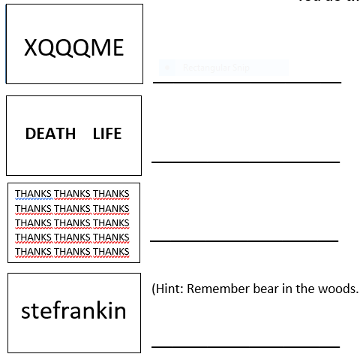

Slide 6
THURSDAY, September 7, 2017 Always have a pencil and SSR materials on your desk when the late bell rings! 1) If you have paper work to return, please get it out and turn it in to the box next to the phone. 2) Bellwork: Captioning 3) Today you will take the 8th grade diagnostic exam. This assignment is used to show your teacher what you know and what you need to know as we move forward. Try your best! What you show about what skills you have determines how your learning goes into the future! 4) If we have time, we will begin presentations (If we don’t do them today, we will do them on Monday). PRESENTATIONS WILL CONSIST OF: STANDING UP AT YOUR DESK IF YOUR BACK IS TO ANYONE IN CLASS, FIND A PLACE TO STAND WHERE IT ISN’T TELL US YOUR NAME, SHOW US YOUR SQUARE, AND EXPLAIN WHAT IS ON IT AND WHAT IT SYMBOLIZES ABOUT YOU. THE END ☺

Slide 7
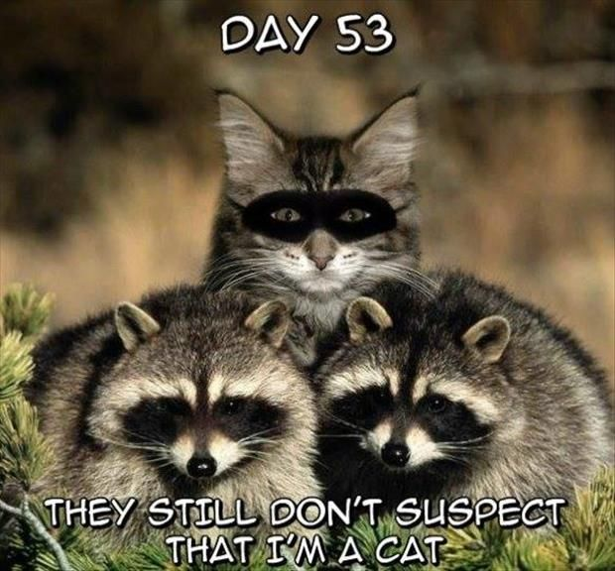
Think of writing captions like creating memes. The difference is, if the ‘meme’ is good, people will want to read the story that goes with it! This is called the loop. Captions don’t tell the whole story, but intrigues the reader and makes them want to read more. They can be serious, funny, mysterious, etc., but they should give enough info to guess what’s going on without just telling us what is obvious.
Write a caption here for the picture (if it sounds like a meme, that’s ok!):

Slide 8
Friday, September 8, 2017 Always have a pencil and SSR materials on your desk when the late bell rings! 1) If you have paper work to return, please get it out and turn it in to the box next to the phone. 2) Bellwork: Quizlet Live (get out your laptop and go to Quizlet live and sign up) 10 minutes DO NOT DO THE NEXT STUFF WITHOUT MS.L 4) Book Chats: a) Get out your reading log! Yup, that’s today!! b) Go to Ms. L’s website (you have it bookmarked) c) Click on “Weekly Reading and Friday Book Chats” tab d) READ ALL OF THE INSTRUCTIONS ON THE PAGE!!!! MS. L WILL WALK YOU THROUGH THE FIRST CHAT OF THE YEAR AFTER YOU HAVE READ YOUR INSTRUCTIONS.

