Slide 1
HOMEROOM ALWAYS READ THE BOARD FIRST ☺ 1) Come in and find your seat. If you have any paperwork to return, please get it out and have it ready on your desk. Thanks! 2) You need a pencil or pen today; make sure your pencil is sharpened. 4) When the announcements come on, you should be quiet, still, and listening. 5) When announcements are finished, we will move on.

Slide 2
Monday, September 11, 2017 Always have a pencil and SSR materials and your folder on your desk when the late bell rings! 1) If you have paper work to return, please get it out and turn it in to the box next to the phone. 2) Get your computer up and running : first check email and sign up for commonlit. THEN: 3) Bellwork for today is synonyms and antonyms. When finished, move on to number 4 below. YOU HAVE 10 MINUTES ONCE THE LATE BELL RINGS! 4) Get out your identity square and look over it. Prepare to present your work. PRESENTATIONS WILL CONSIST OF: SPEAKING LOUDLY ENOUGH TO BE HEARD, STANDING UP AT YOUR DESK (IF YOUR BACK IS TO ANYONE IN CLASS, FIND A PLACE TO STAND WHERE IT ISN’T) TELL US YOUR NAME, SHOW US YOUR SQUARE, AND EXPLAIN WHAT IS ON IT AND WHAT IT SYMBOLIZES ABOUT YOU. THE END ☺

Slide 3
PRESENTATION GUIDELINES 1) Stand so your back is not to anyone. 2) Introduce yourself with your name. 3) Point out each symbol on your square, one at a time, and explain: a) What it is and what category it’s in b) What it stands for about your identity SPEAK LOUDLY ENOUGH FOR THE ROOM TO HEAR YOU Try to look at your audience (fake it by looking right over their heads) You’ve got this.

Slide 4
Tuesday, September 12, 2017 Always have a pencil and SSR materials and your folder on your desk when the late bell rings! 1) If you have paper work to return, please get it out and turn it in to the box next to the phone. 2) Start your computer and then begin your Bellwork: VOCABULARY IN CONTEXT
3) BEGIN IDENTITY UNIT (WE DID THE PRE-IDENTITY UNIT) A) If you have not already, open your email and find the one that says “CREATE AN ACCOUNT” in the subject line. Open the email and follow the link to create your account. B)If you have already created your account, go to my website. D) Click on the “Common Lit” tab. E) Sign in and follow the prompts to find your assignment: “The Treasure of Lemon Brown.” You will read and answer the guided reading questions as they appear. F) When finished reading, you will take the assessment. G) When finished with the assessment, open the discussion tab and, on your own paper, answer each question in at least three complete sentences.
IF YOU FINISH BEFORE YOUR CLASSMATES, YOU MAY READ OR WORK ON QUIZLET

Slide 5
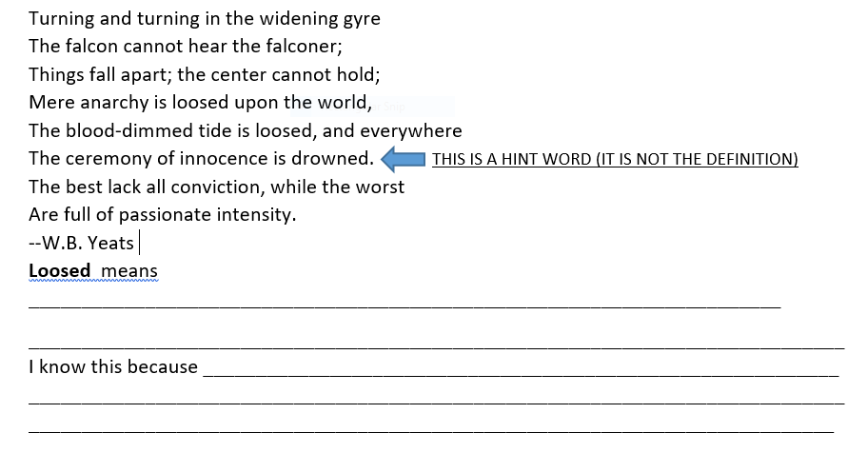

Slide 6
1) What characteristics make up a person’s identity? 2) How does a person’s experiences shape his/her identity? Our learning targets for this unit: By the end of our unit, you should be able to say, “I can….. “read closely and analyze text” “write using credible evidence to support my claim” “determine a theme or central of a text and analyze its development and how it relates to the characters, setting, and plot.” “provide an objective summary.” “analyze how particular lines of dialogue or events in a story moves the action, reveals aspects of a character, or provoke a decision.” “analyze how differences in the points of view of the characters and the audience or reader create such effects as suspense or humor.” “determine a central idea of a non-fiction text and analyze its development and its relationship to supporting ideas.” “determine an author’s point of view in a text and analyze how the author acknowledges and responds to conflicting evidence or viewpoints.”

Slide 7
Wednesday, September 13, 2017 Always have a pencil and SSR materials and your folder on your desk when the late bell rings! BEHAVE YOURSELF AND BE KIND!! 1) If you have paper work to return, please get it out and turn it in to the box next to the phone. 2) Bellwork for today is Rebus Puzzles 3) Finish reading “The Treasure of Lemon Brown” and answering your guided questions. This is individual work and volume should be at zero (for no talking) unless you are asking for help from your desk community. A) Get the guided reading questions from your folder. B) Go to my webpage. C)Click on in class assignments. D) Click on “The Treasure of Lemon Brown” Continue reading and answering questions as you read. IF YOU FINISH BEFORE YOUR CLASSMATES, YOU MAY EITHER: READ OR WORK ON LEARNING YOUR QUIZLET VOCABULARY WORDS.

Slide 8
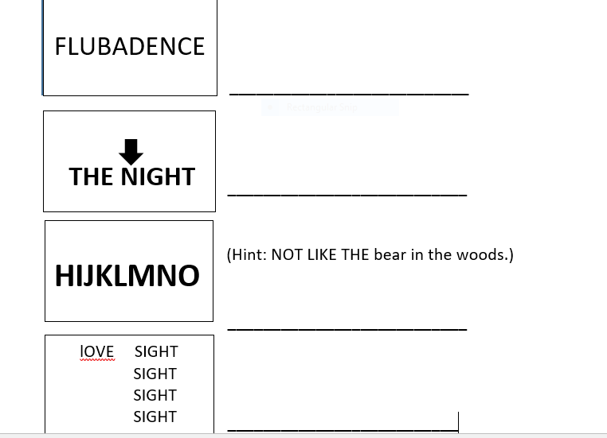
Bad Influence
In the middle of the night
H2O
Love at first sight

Slide 9
THURSDAY, September 14, 2017 Always have a pencil and SSR materials on your desk when the late bell rings! 1) If you have paper work to return, please get it out and turn it in to the box next to the phone. 2) Bellwork: Captioning 3) Recap of Lemon Brown and listen to Big Walter Horton. 3) Close reading of “The Treasure of Lemon Brown” in order to connect the story with our identity theme. 4) SSR

Slide 10
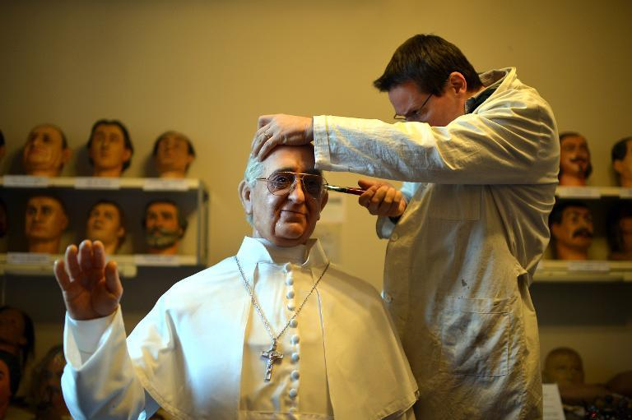
Think of writing captions like creating memes. The difference is, if the ‘meme’ is good, people will want to read the story that goes with it! This is called the loop. Captions don’t tell the whole story, but intrigues the reader and makes them want to read more. They can be serious, funny, mysterious, etc., but they should give enough info to guess what’s going on without just telling us what is obvious.
Write a caption here for the picture (if it sounds like a meme, that’s ok!):

Slide 11
Friday, September 8, 2017 Always have a pencil and SSR materials on your desk when the late bell rings! 1) If you have paper work to return, please get it out and turn it in to the box next to the phone. Quizlet Code 2) Bellwork: Quizlet Live (get out your laptop and go to Quizlet live and sign up) 10 minutes DO NOT DO THE NEXT STUFF WITHOUT MS.L 4) Book Chats: a) Get out your reading log! Yup, that’s today!! b) Go to Ms. L’s website (you have it bookmarked) c) Click on “Weekly Reading and Friday Book Chats” tab d) READ ALL OF THE INSTRUCTIONS ON THE PAGE!!!! MS. L WILL WALK YOU THROUGH THE CHAT AFTER YOU HAVE READ YOUR INSTRUCTIONS.

